Slide 1
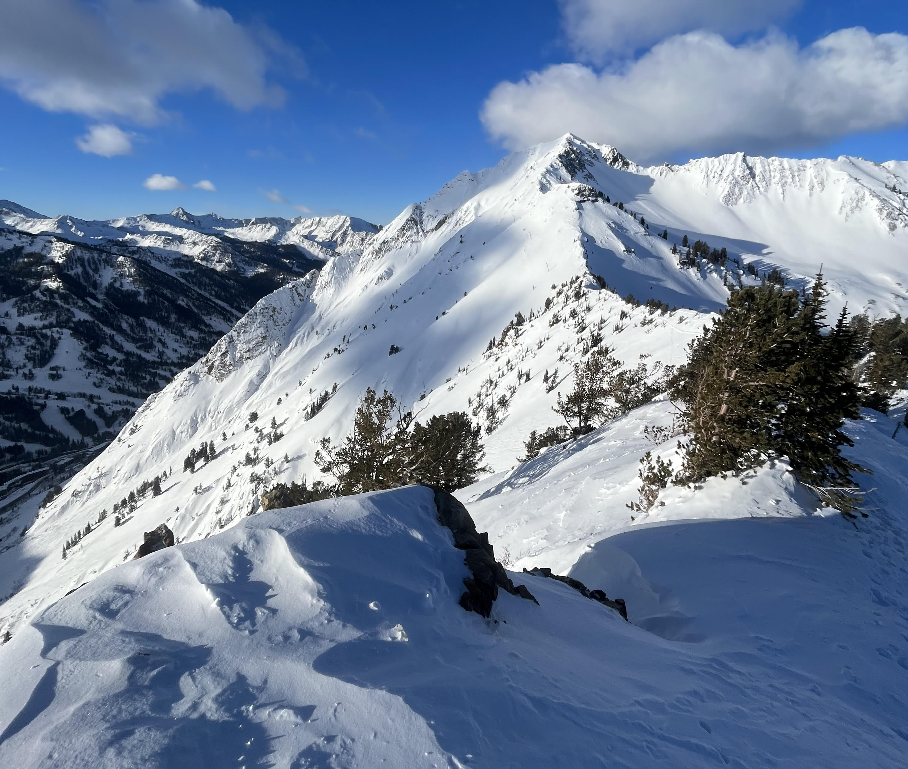
Snow Depth Prediction Model
Subtitle: A comprehensive analysis using Random Forest and Bayesian Optimization
Author: Audrey Malloy
Date: April 8th, 2025

Slide 2
Introduction:
background on snow prediction
importance to industries
objective

Slide 3
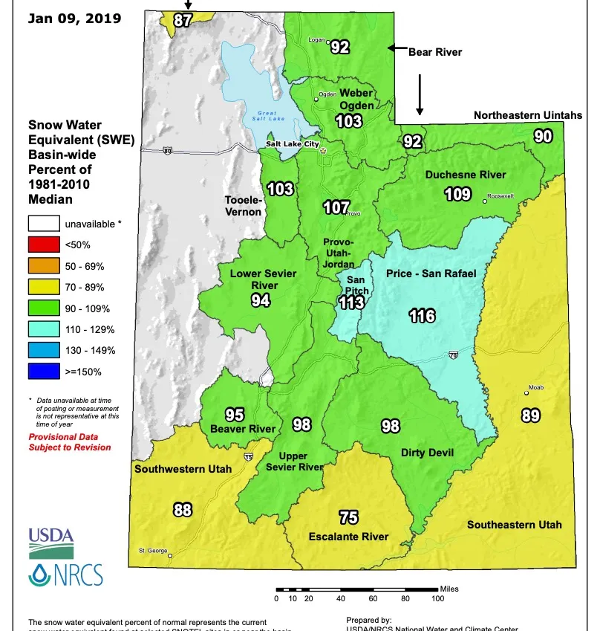
The Importance of Snow
Water Source
Climate Impact
Economic Value
Ecosystem Support
Notes:
The Importance of Snow
Water Source: Snow serves as a natural reservoir, storing water crucial for agriculture ecosystems and urban needs
Climate Impact: Reflects sunlight regulates global temps and mitigates warming
Econ value: vital for winter tourism, recreational industrices and local econ
ecosystem support: essential for wildlife habitats and plant survival in snowy regions

Slide 4







Who does this impact?
Notes:
Ski resorts
Local communities and municipalities
Transportation organizations
Avalanche centers
Forest Service and other research agencies

Slide 5



Problem Statement:
Why Snow Depth Prediction Matters?
1. Snow depth unpredictability impacts water management and recreation industries.
2. Improved forecasts can enhance water planning and promote sustainable tourism.
3. Existing methods struggle with accuracy in diverse climates.
Notes:
The unpredictable nature of snow depth poses challenges for resource planning in water management and recreational industries. Current prediction methods often lack accuracy in varying climates. A model that improves snow depth forecasts could help optimize water usage and support sustainable tourism.

Slide 6
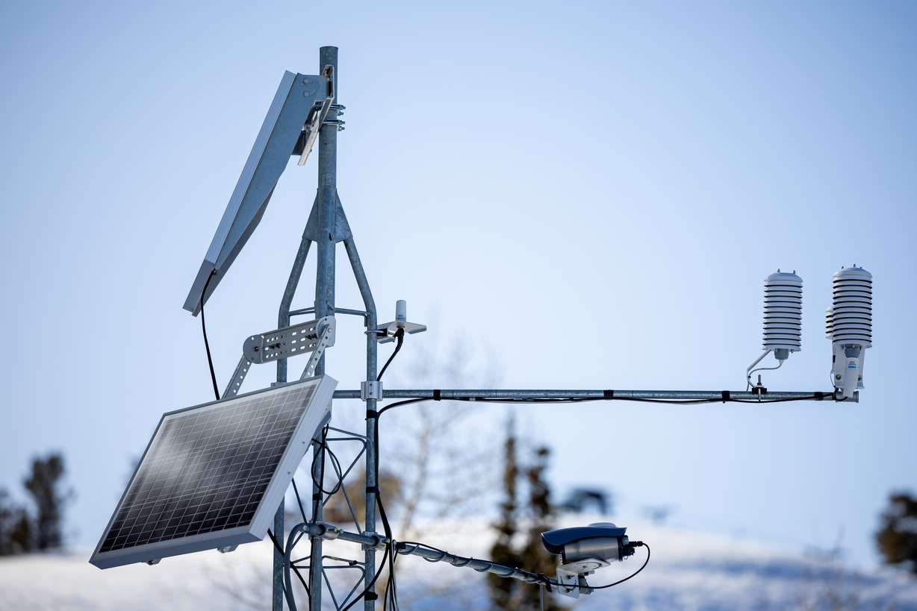
Data Source
All data for this project was acquired from the SNOTEL (SNOw TELemetry) sites.
Environmental metrics include:
-Snow Depth
-Precipitation
-Air temperature
-Soil temperature and moisture
Notes:
Max, min, obs, avg environmental factors

Slide 7
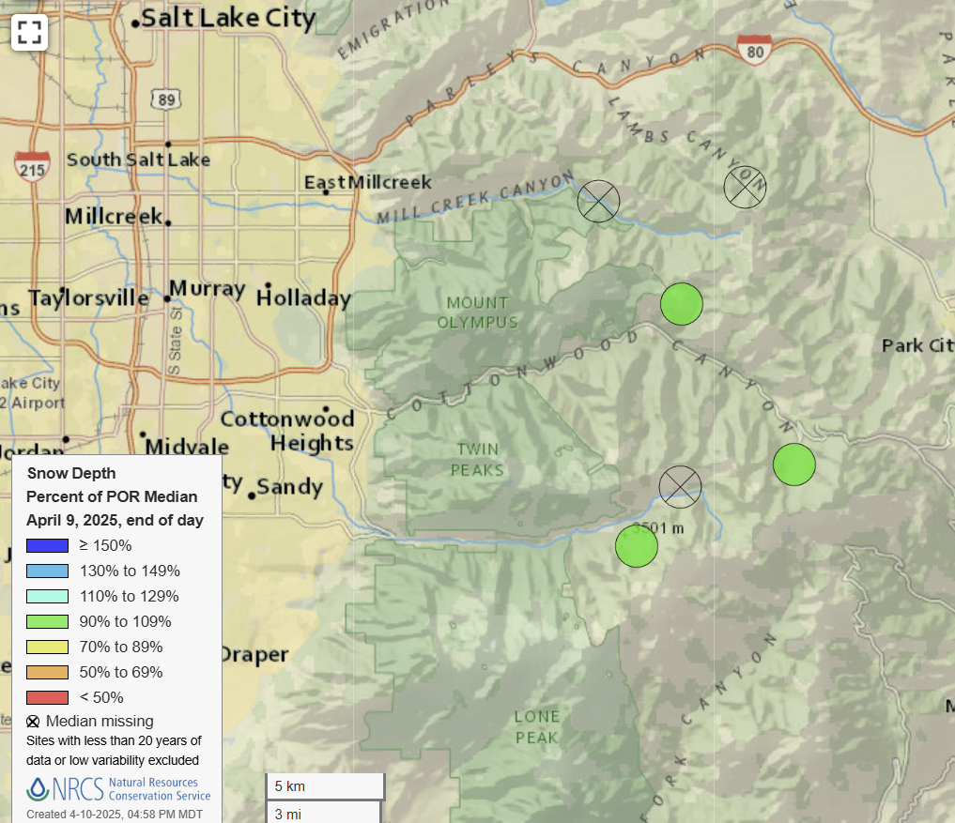
Station Sites:
Brighton: 8790 m
Dry Fork: 8940 m
Mill-D : 7190 m

Slide 8
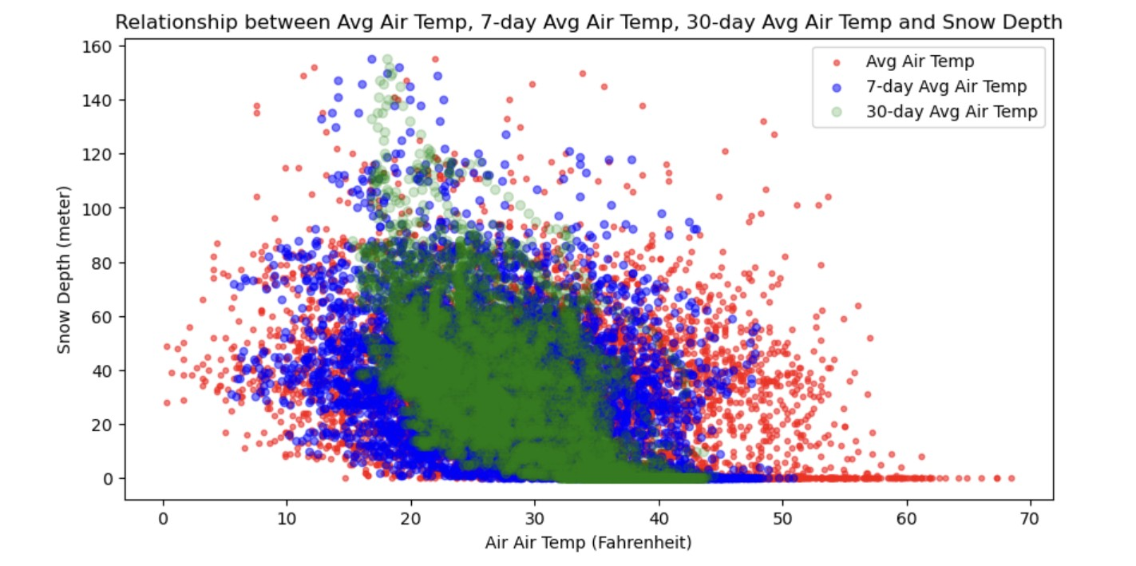
Data Wrangling
Time Series Data Windowing
Windowing Intervals:
7-Day
30-Day
Statistical Metrics Calculated:
Variance
Standard Deviation
Mean
Maximum
Minimum
Sum

Slide 9
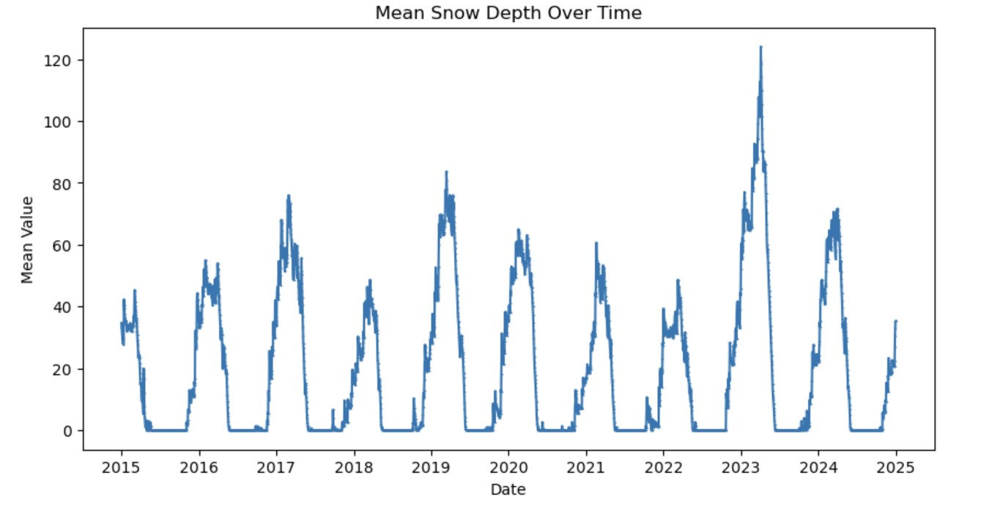
Exploratory Data Analysis
Use seasonal data -> months Nov – May to avoid skewed data
Notes:
Decided to use months with more winter snow conditions to avoid non-snow month's ability to skew results.

Slide 10
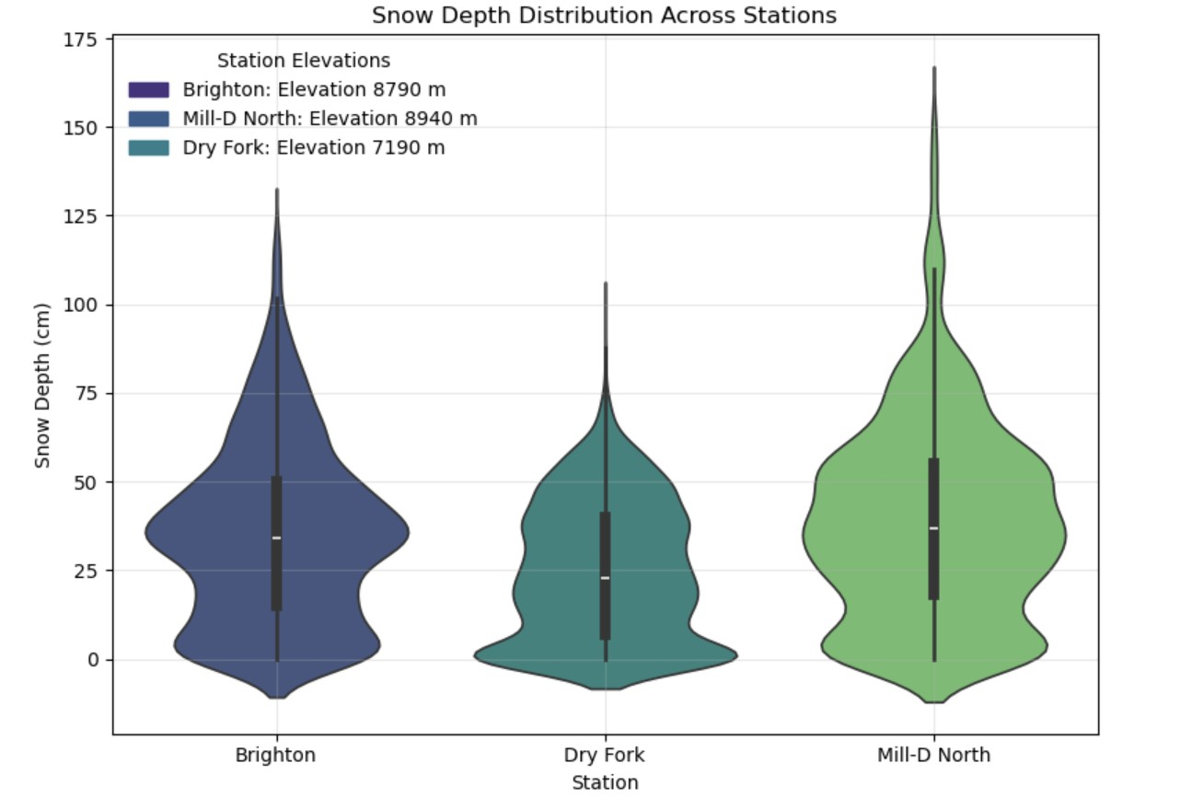
Exploratory Data Analysis cont.
Snow depth variability across different stations (e.g., Brighton, Mill-D North, Dry Fork) and elevation ranges.
Higher elevations consistently showed greater snow depth.

Slide 11
Correlation Analysis
Strong Positive Correlations:
7-Day Snow Depth Metrics: Extremely strong (e.g., avg, sum, max: 0.988).
30-Day Metrics: Strong but slightly weaker (e.g., min: 0.923, avg: 0.916).
Moderate Positive Correlations:
Precipitation: Metrics like 30d_precip_std (0.620) and precip_accumulation (0.589).
Weak Correlations:
Geographical Variables: Latitude (0.239), Elevation (0.236).
Soil Moisture: Very weak (e.g., soilmoisture_avg 0.073).
Negative Correlations:
Air Temperature: Inverse relationship (e.g., airtemp_avg -0.279).
Soil Temperature: Stronger negative impact (soiltemp_max -0.454).

Slide 12
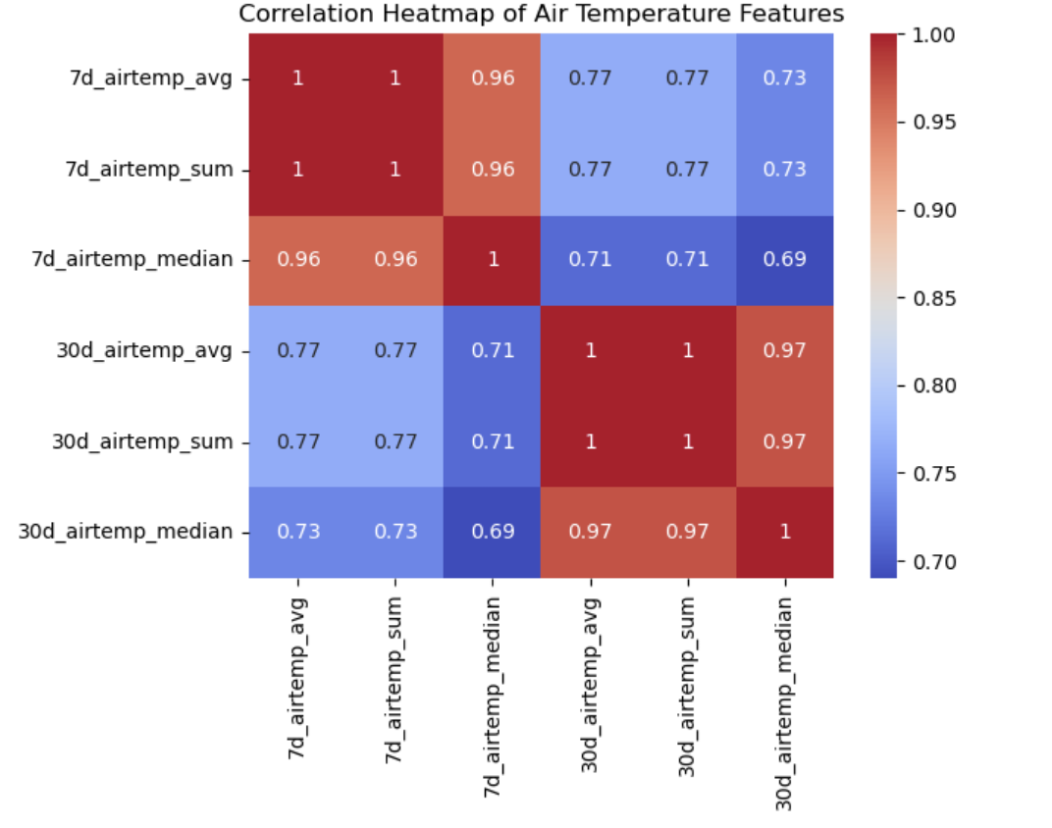
Correlation Analysis cont.
Short-Term Metrics Dominate:
- Snow depth-specific 7-day metrics had the strongest correlations with the target variable

Slide 13
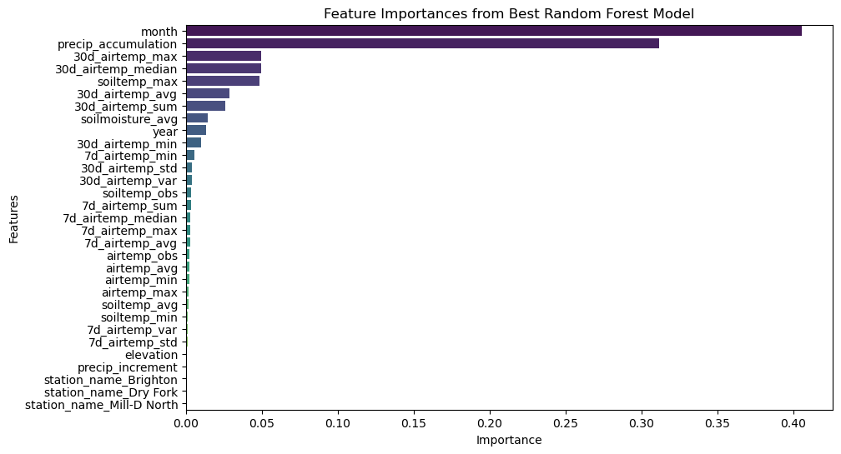
Feature Importance
Key Feature Insights
Seasonality Leads: Month and precipitation accumulation
Temperature effect: Moderate to low importance
Optimization tip: Remove low-importance features (e.g., precip_increment and soiltemp_avg)

Slide 14
Model Design
Models: | RMSE*:
Decision Tree Regressor | +/- 4.62 cm
Support Vector Machine (SVM) | +/- 9.73 cm
Random Forest Regressor | +/- 3.03 cm
Model Comparison for Snow Depth Prediction
Decision Tree Regressor
Support Vector Machine (SVM)
Random Forest Regressor
*Root Mean Square Error (RMSE): calculates the average magnitude of errors between predicted and observed values. By taking the square root of the mean of squared errors, it gives a measure in the same units as the variable being predicted (e.g., centimeters for snow depth).
Notes:
Decision Tree Regressor: Captures complex environmental factors and non-linear relationships.
Support Vector Machine (SVM): Excels in analyzing complex, high-dimensional data.
Random Forest Regressor: Balances accuracy and generalization; highlights key features.

Slide 15
Fine-tuning Hyperparameters
Optimization methods used on Random Forest:
GridSearchCV
RandomizedSearchCV
Bayesian Optimization (Optuna)

Slide 16
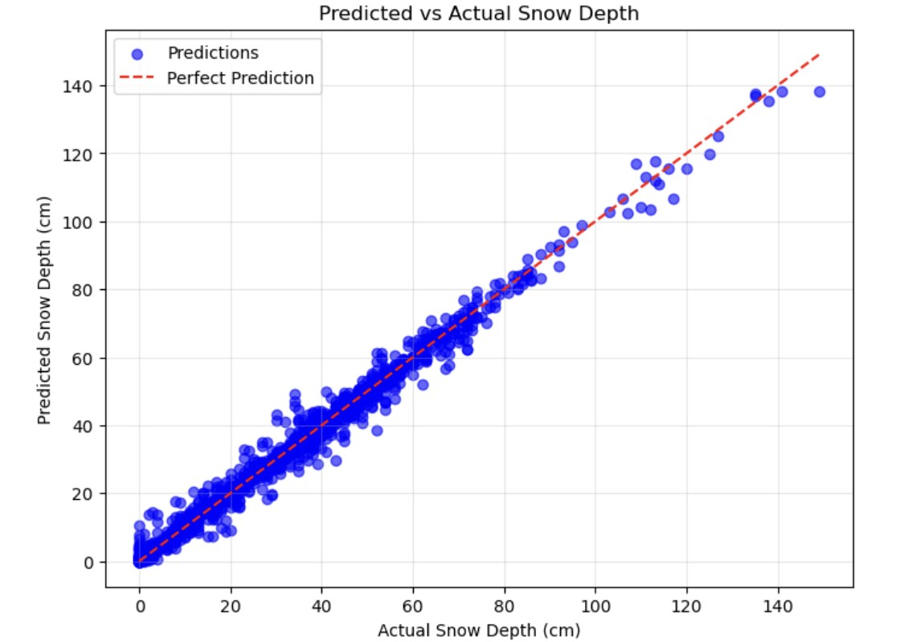
Findings
Final model used Bayesian method (RMSE = ~3.00 ).
Random Forest Regressor with Optuna: Identified as the best model

Slide 17
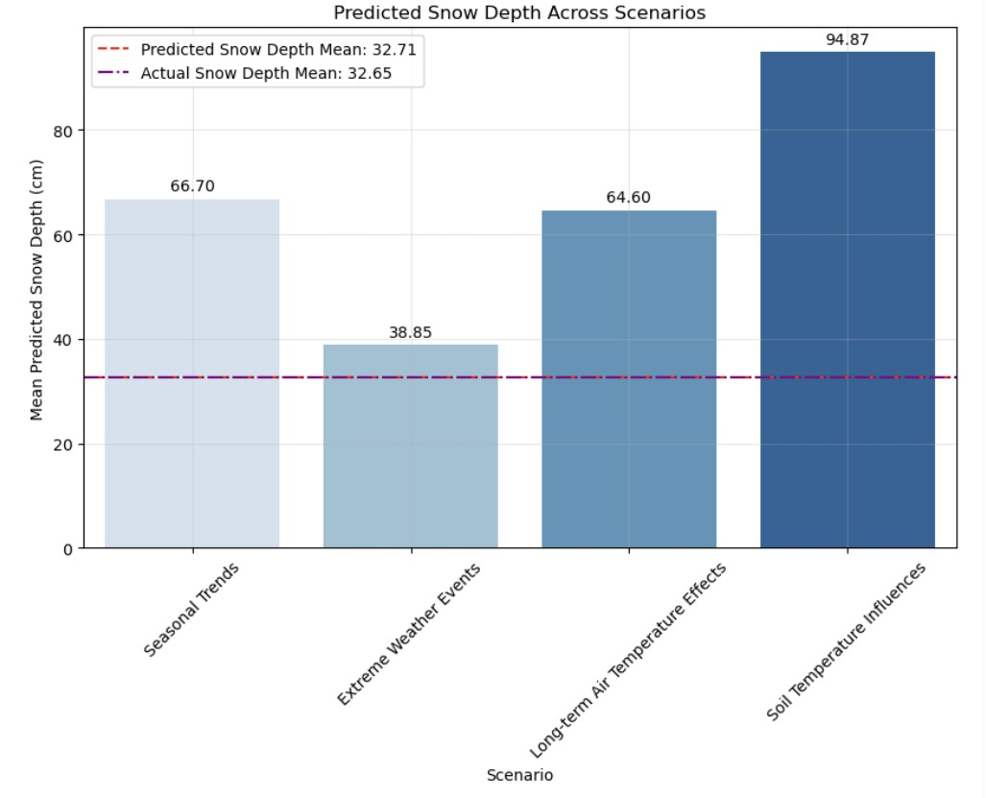
Applications:
Real-time snow depth predictions and scenario analysis for extreme weather events.
Notes:
Using scenarios from a predictive model provides valuable insights and practical benefits

Slide 18
Limitations and Future Work
Limitations
Limited features in the dataset (e.g., no wind speed or snowfall type).
Regional specificity may impact generalization to diverse geographies.
Future directions:
Expand dataset to more meteorological features
Test across climate scenarios
Geographic customization
Integrate hydrology models to complete a snowmelt impact study
Explore advanced machine learning algorithms (e.g., Deep Learning)

Slide 19
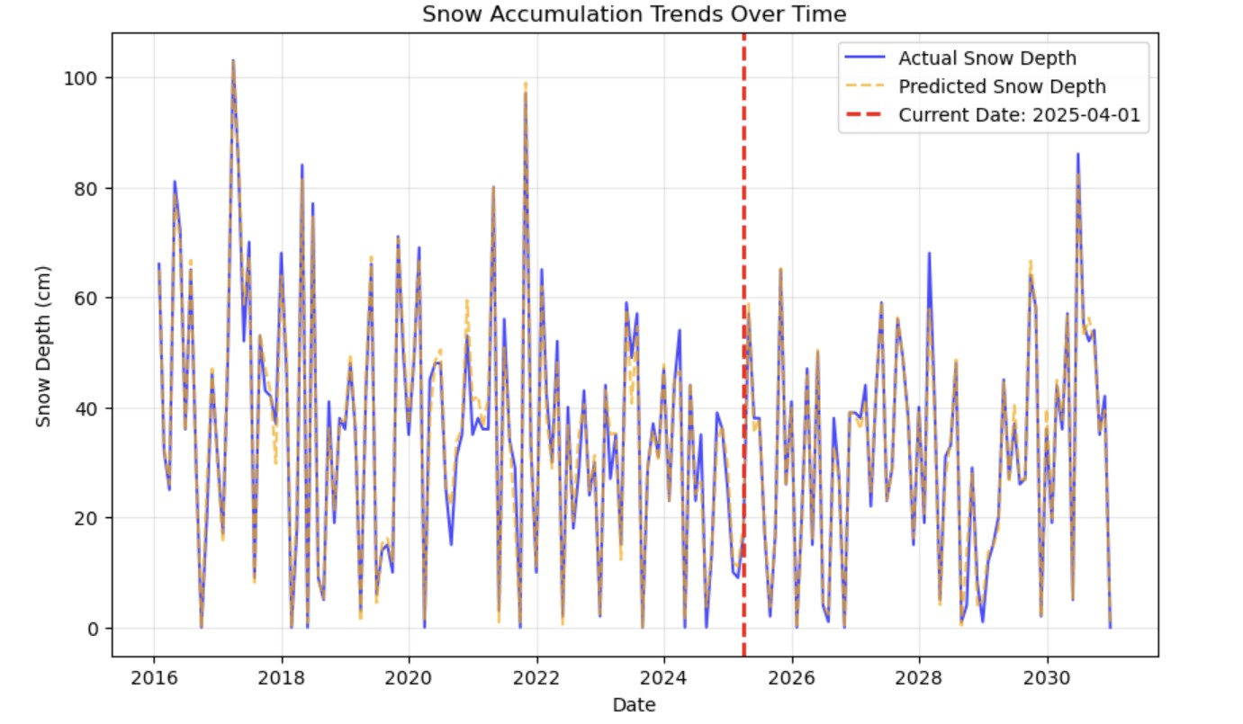
Conclusion
The results suggest the importance of integrating environmental, temporal, and statistical data to enhance prediction accuracy.

Slide 20
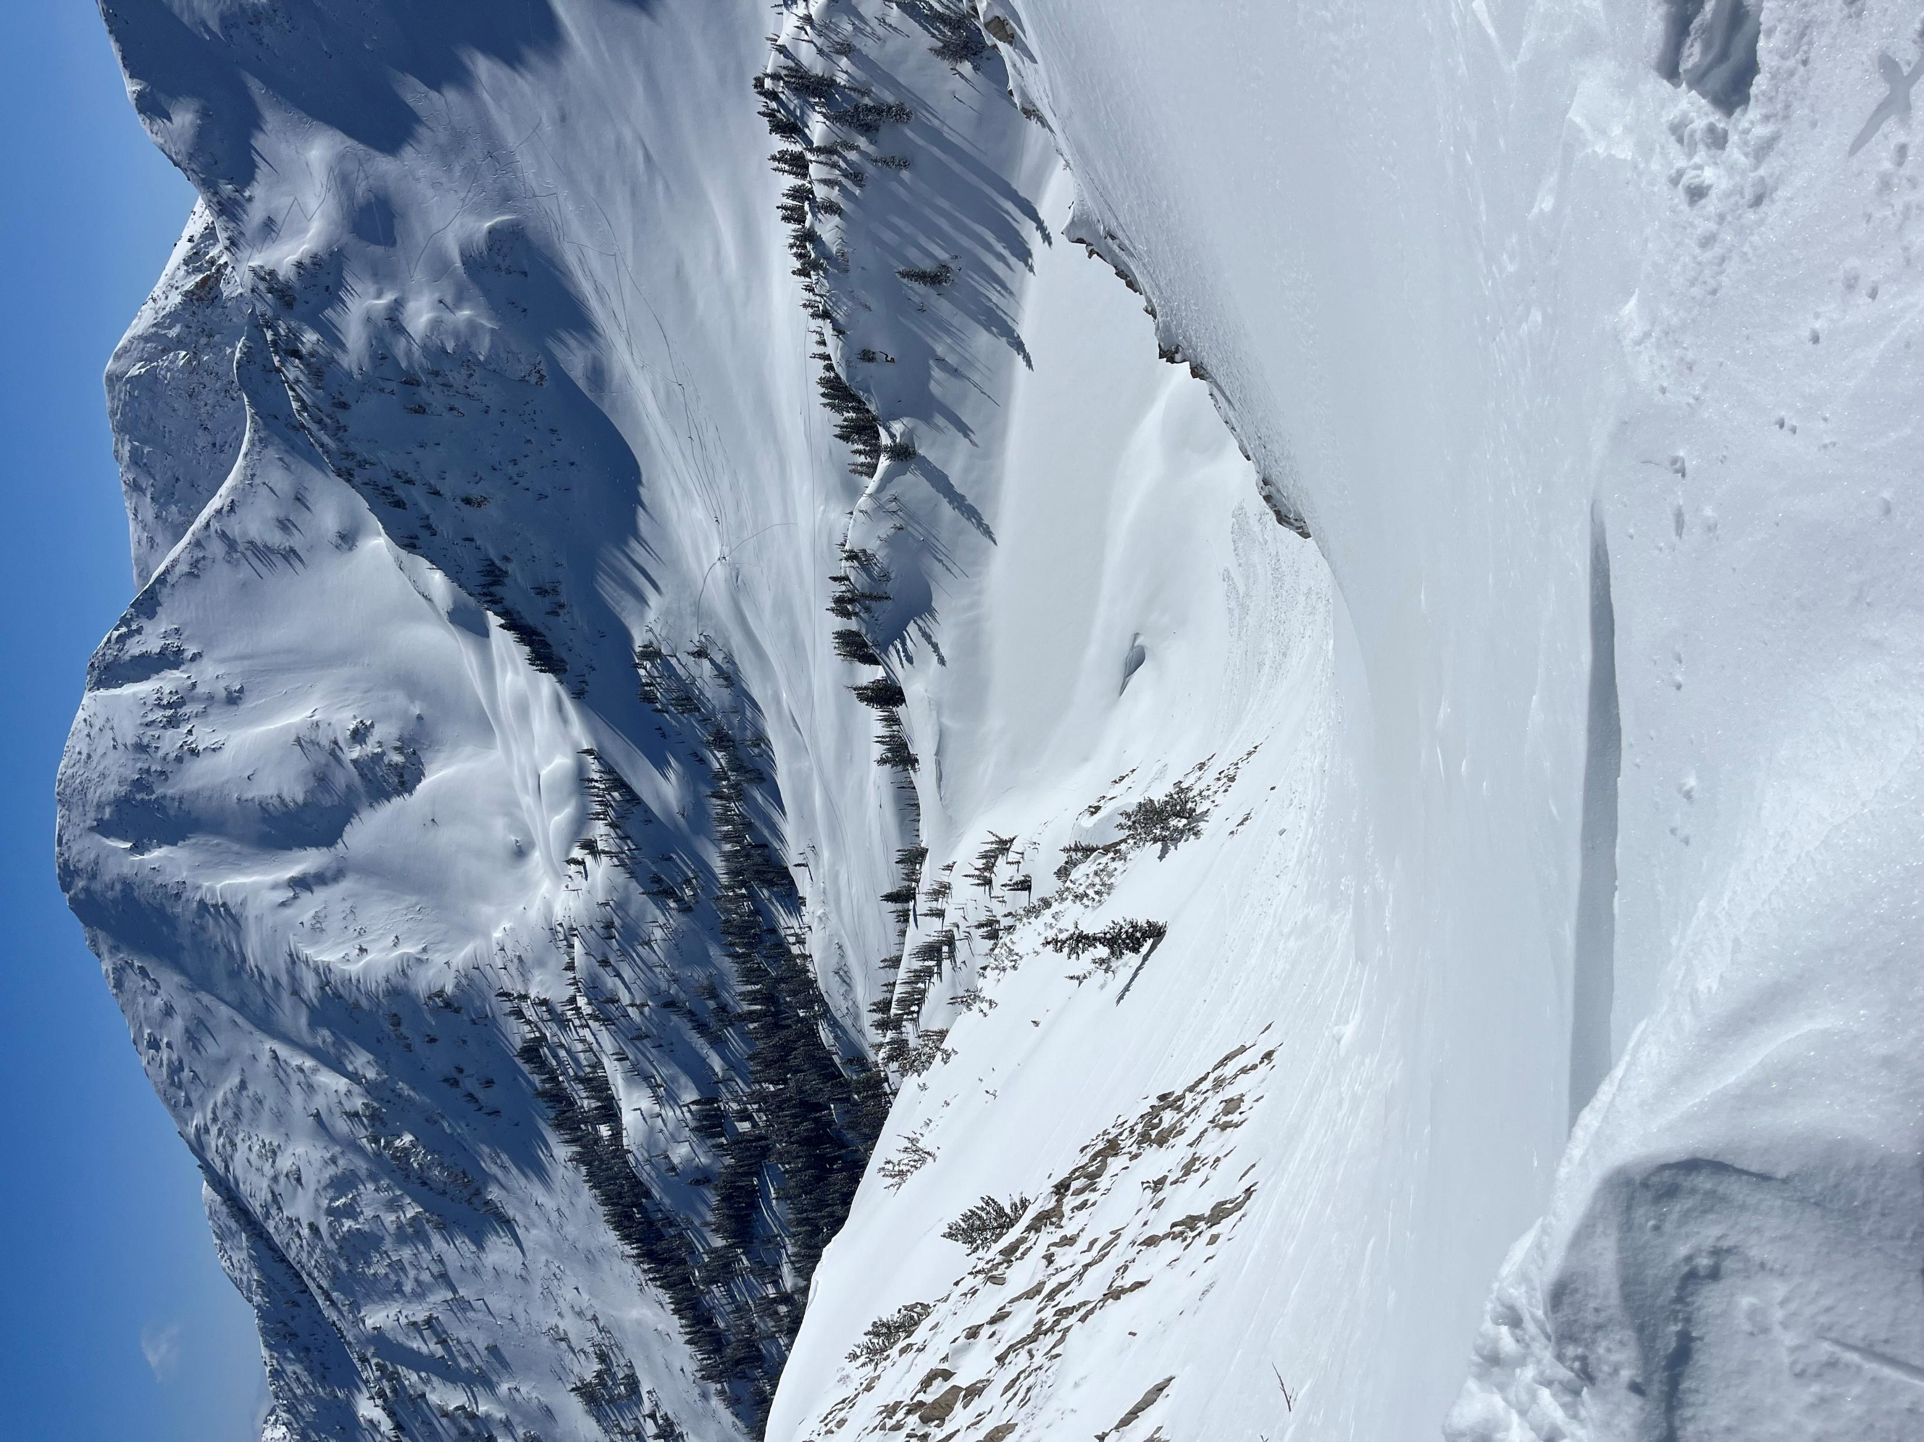
References:
U.S. Department of Agriculture (USDA)
National Water and Climate Center: https://www.nrcs.usda.gov/resources/data-and-reports/snow-and-climate-monitoring-predefined-reports-and-maps

